Slide 1
Predicting Customer Churn in Telecom Industry using Power BI or Tableau and SQL
Name: Rajasekaran K
Batch: MBE11
Course Name: Master of Business Analytics with Digital Marketing

Slide 2
Project Overview
The goal of this project is to identify key factors driving customer churn and predict churn likelihood, supporting several critical business objectives:
Problem Statement: Predicting Customer Churn in Telecom Industry
Business Use Cases:
Customer Retention: Identify at-risk customers and proactively implement retention strategies.
Marketing Campaigns: Tailor marketing efforts towards customers who are more likely to churn.
Service Improvement: Analyze churn patterns to improve service offerings and customer support.
Revenue Optimization: Reduce churn rates to maintain a steady revenue stream.
Customer Segmentation: Segment customers based on churn probability to offer personalized experiences.

Slide 3
Data Preprocessing
Steps:
Checking Data type of each column
Remove any duplicate entry in customer id
Delete NULL value from Customer ID
Update “NILL” for blank cells churn category, churn reason
Negative values in Monthly charge, monthly charge should not be negative, change it to positive value
Steps Attached.

Slide 4
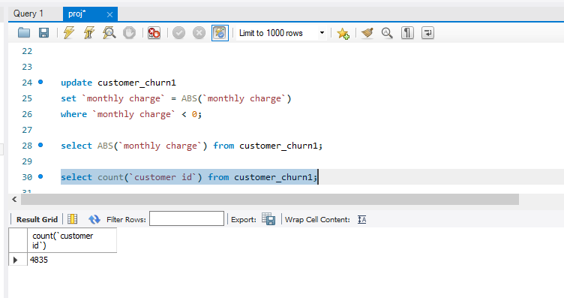
Reports
Ques1. Identify the total number of customers and the churn rate

Slide 5
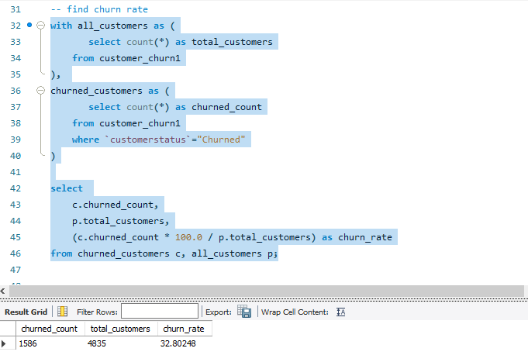
Reports
Ques1. Identify the total number of customers and the churn rate

Slide 6
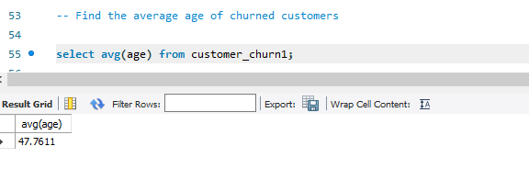
Reports
Ques2. Find the average age of churned customers

Slide 7
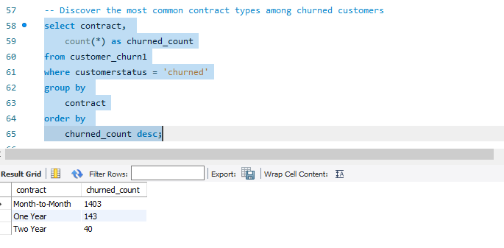
Reports
Ques3. Discover the most common contract types among churned customers

Slide 8
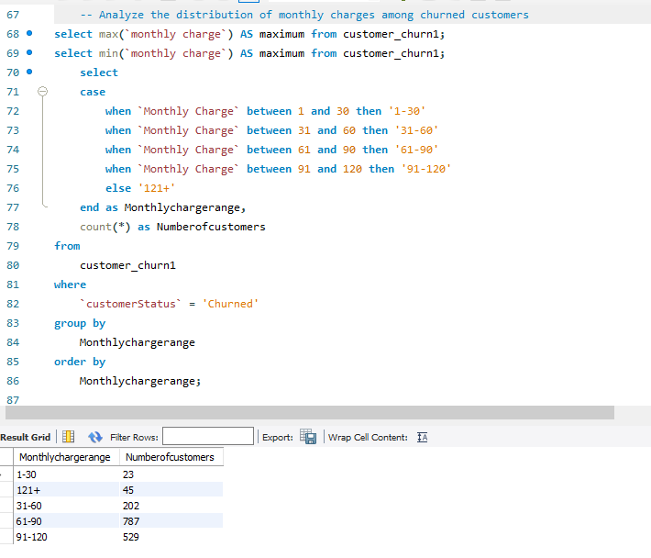
Reports
Ques4. Analyze the distribution of monthly charges among churned customers

Slide 9
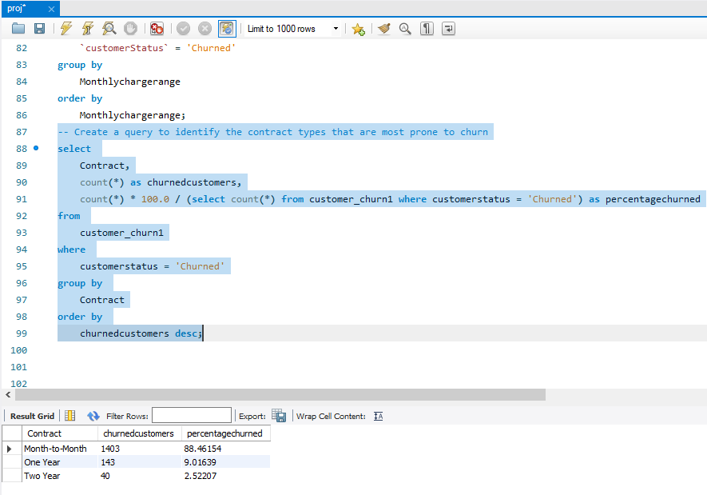
Reports
Ques5. Create a query to identify the contract types that are most prone to churn

Slide 10
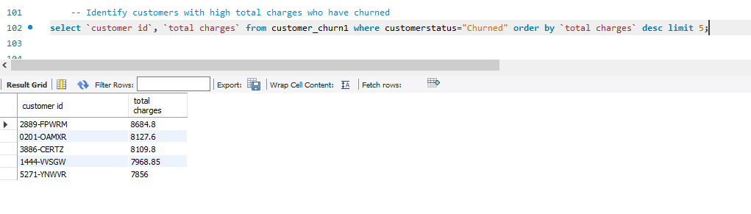
Reports
Ques6. Identify customers with high total charges who have churned

Slide 11
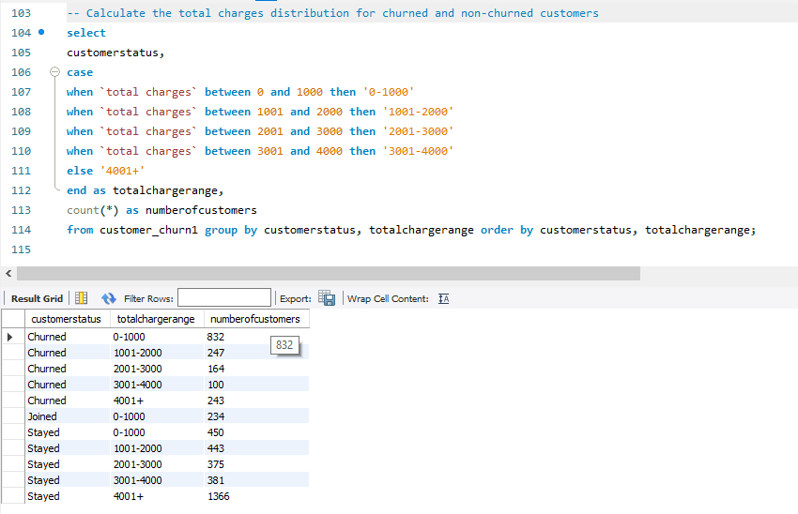
Reports
Ques7. Calculate the total charges distribution for churned and non-churned customers

Slide 12
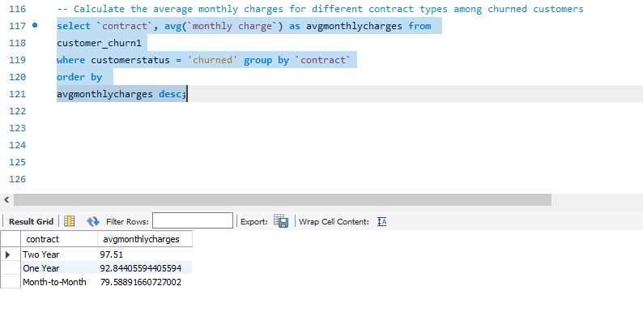
Reports
Ques8. Calculate the average monthly charges for different contract types among churned

Slide 13
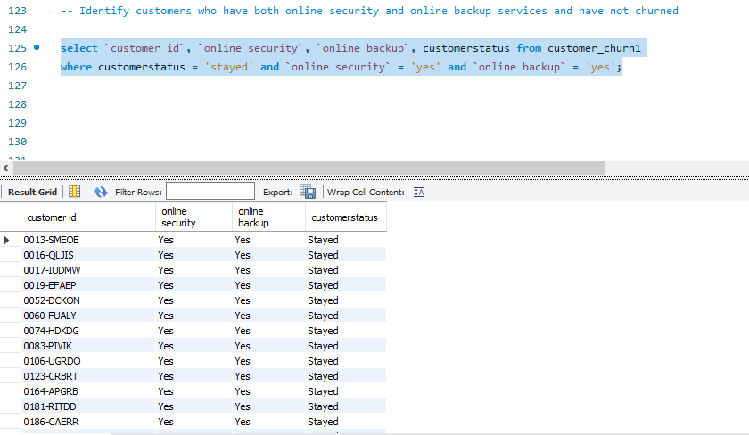
Reports
Ques9. Identify customers who have both online security and online backup services and have not churned

Slide 14
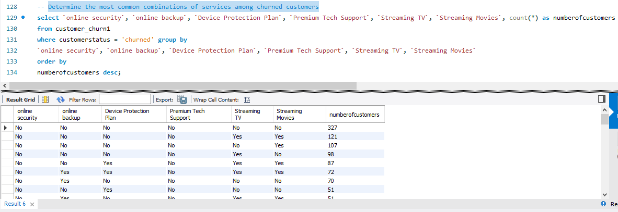
Reports
Ques10. Determine the most common combinations of services among churned customers

Slide 15
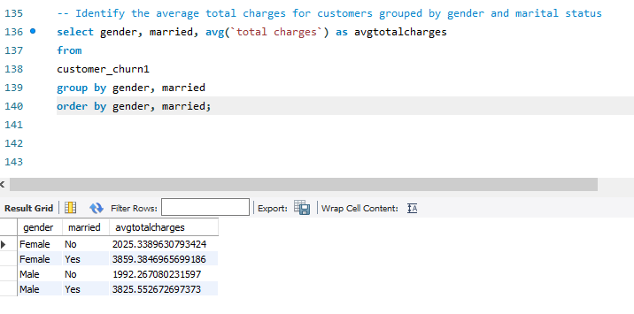
Reports
Ques11. Identify the average total charges for customers grouped by gender and marital status

Slide 16
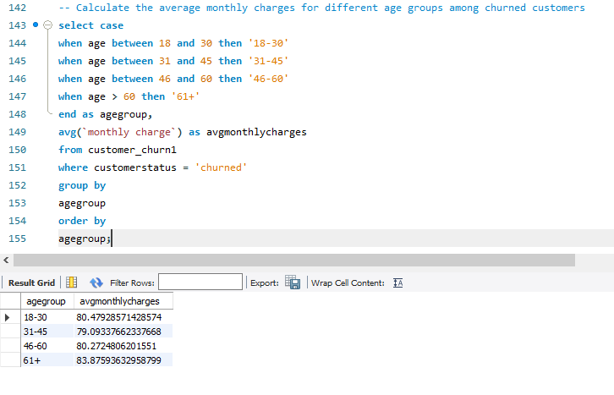
Reports
Ques12. Calculate the average monthly charges for different age groups among churned customers

Slide 17
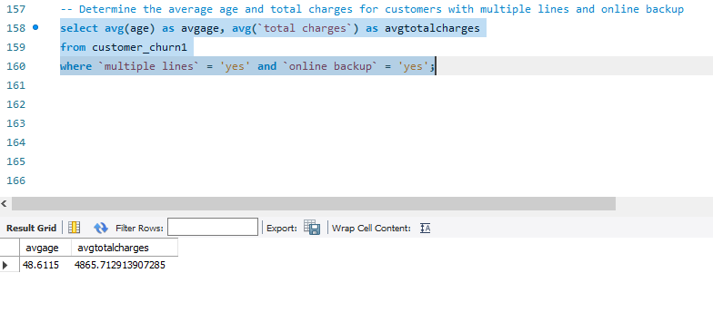
Reports
Ques13. Determine the average age and total charges for customers with multiple lines and online backup

Slide 18
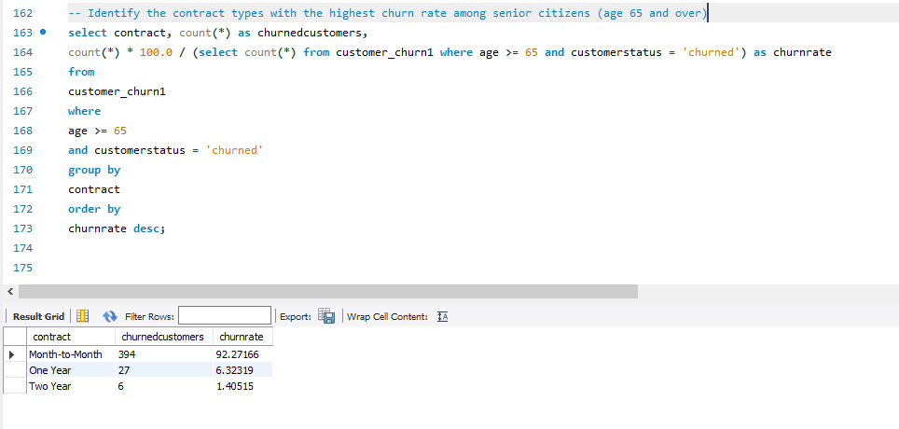
Reports
Ques14. Identify the contract types with the highest churn rate among senior citizens (age 65 and over)

Slide 19
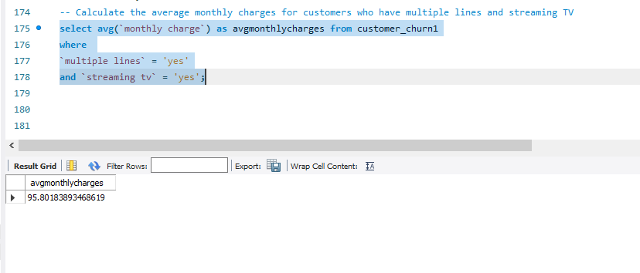
Reports
Ques15. Calculate the average monthly charges for customers who have multiple lines and streaming TV

Slide 20
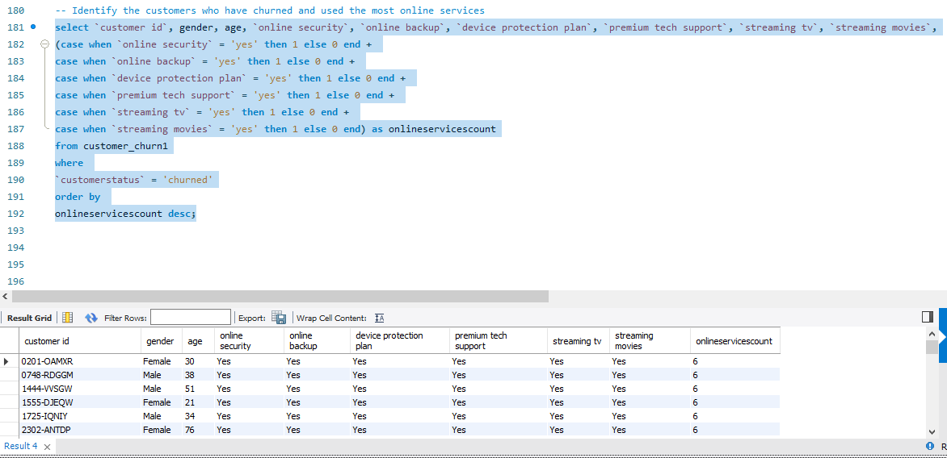
Reports
Ques16. Identify the customers who have churned and used the most online services

Slide 21
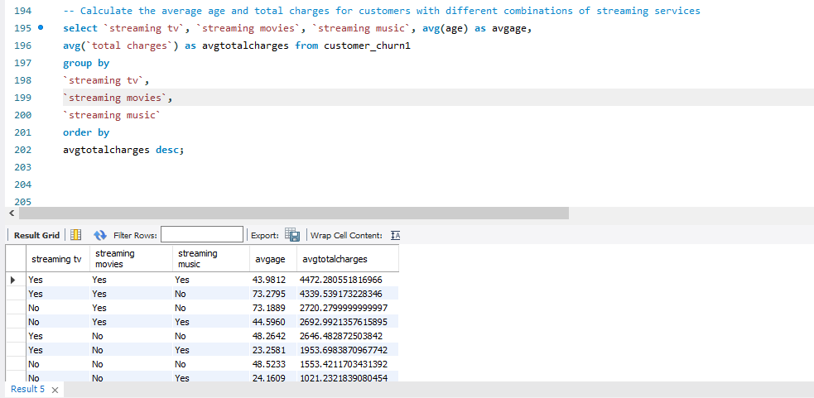
Reports
Ques17. Calculate the average age and total charges for customers with different combinations of streaming services

Slide 22
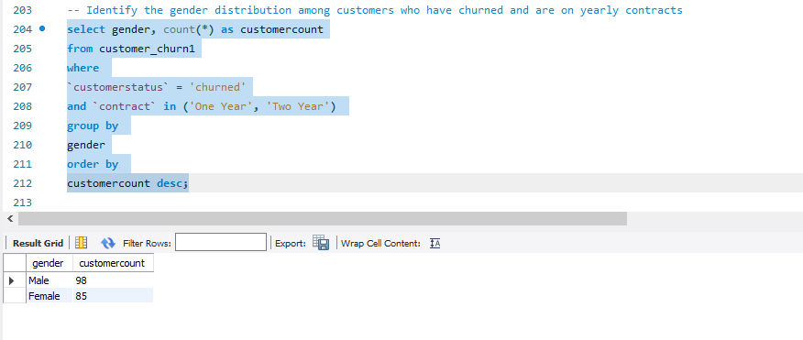
Reports
Ques18. Identify the gender distribution among customers who have churned and are on yearly contracts

Slide 23
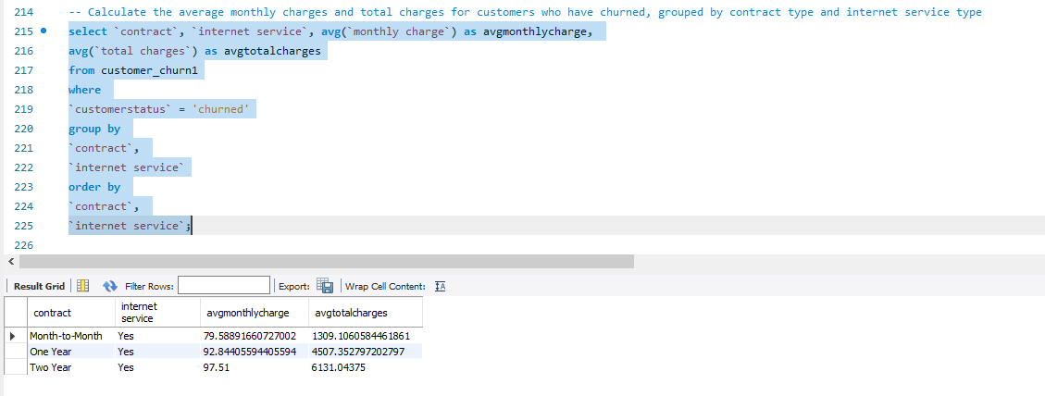
Reports
Ques19. Calculate the average monthly charges and total charges for customers who have churned, grouped by contract type and internet service type

Slide 24
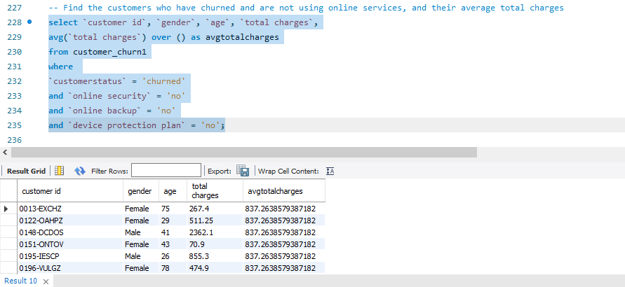
Reports
Ques20. Find the customers who have churned and are not using online services, and their average total charges

Slide 25
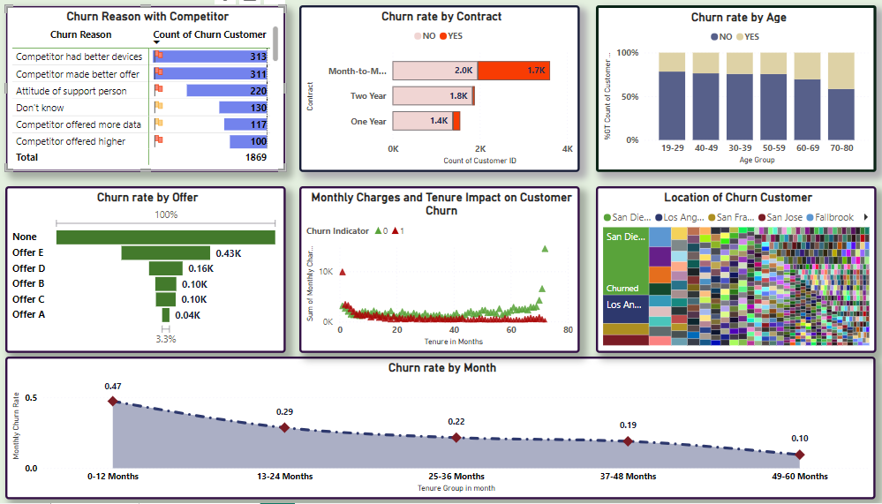
Dashboards

Slide 26
Findings & Advice
Issue
0 – 12 Month Tenure customers are mostly churn
Churn rate increases with customer who have not have any offer
Churn rate increase with Month to Month Contract customers
Customers are churn due to Device problem
Customers are churn due to not have better Offer then others
Customers are churn due to dissatisfaction with support person
Recommendations
Fix the device issue
Try to give better plan to satisfy customers
Train support person to serve better than now

Slide 27
Thank you
END

